Slide 1


Kandean
Personalized your own recipes and digital fridge
22207232 Qiyue Zhu
11/30/2024

Slide 2

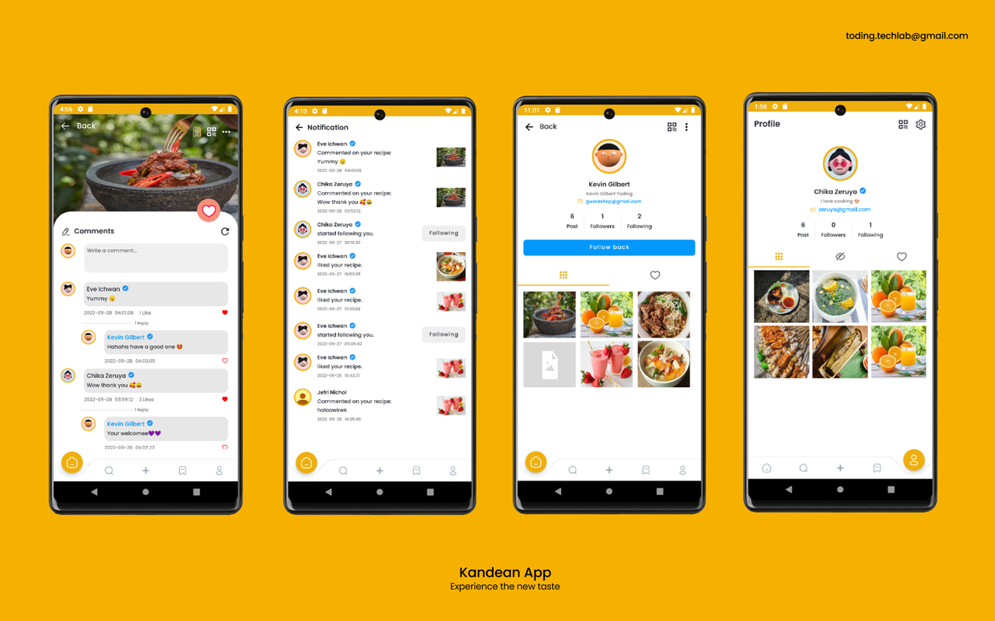
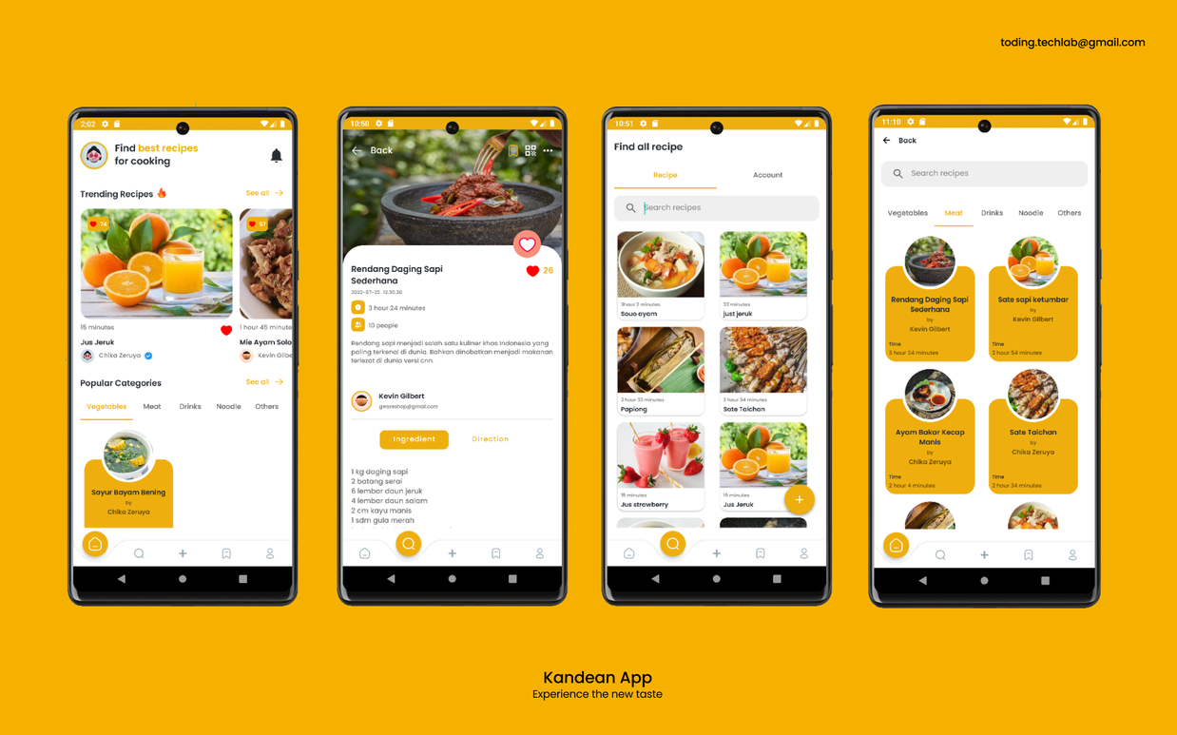
The Chosen App: Kandean
A beautiful UI
Share recipes like Instagram, you can like and comment, and receive notifications when someone likes or comments on your post
Edit your own recipes
Search recipes
Suggest the trending recipes or popular categories
Support QR Code scanning to find recipes and user accounts

Slide 3





Timeline
Set up the new basic pages and layout of the digital fridge page
Add an API that enables users to scan barcodes or items to add new items more easily
BETA
SUBMISSION
Automatically decrease the quantity of an ingredient in the digital fridge when it is used in a recipe.
ALPHA
SUBMISSION
FINAL
SUBMISSION

Slide 4
Function Achieved 1:
Auto-Decreasing Ingredients
Added a feature to automatically decrease the quantity of an ingredient when it's used in a recipe.
Users can click the "USED" button to update quantities or delete items that are completely used.

Slide 5
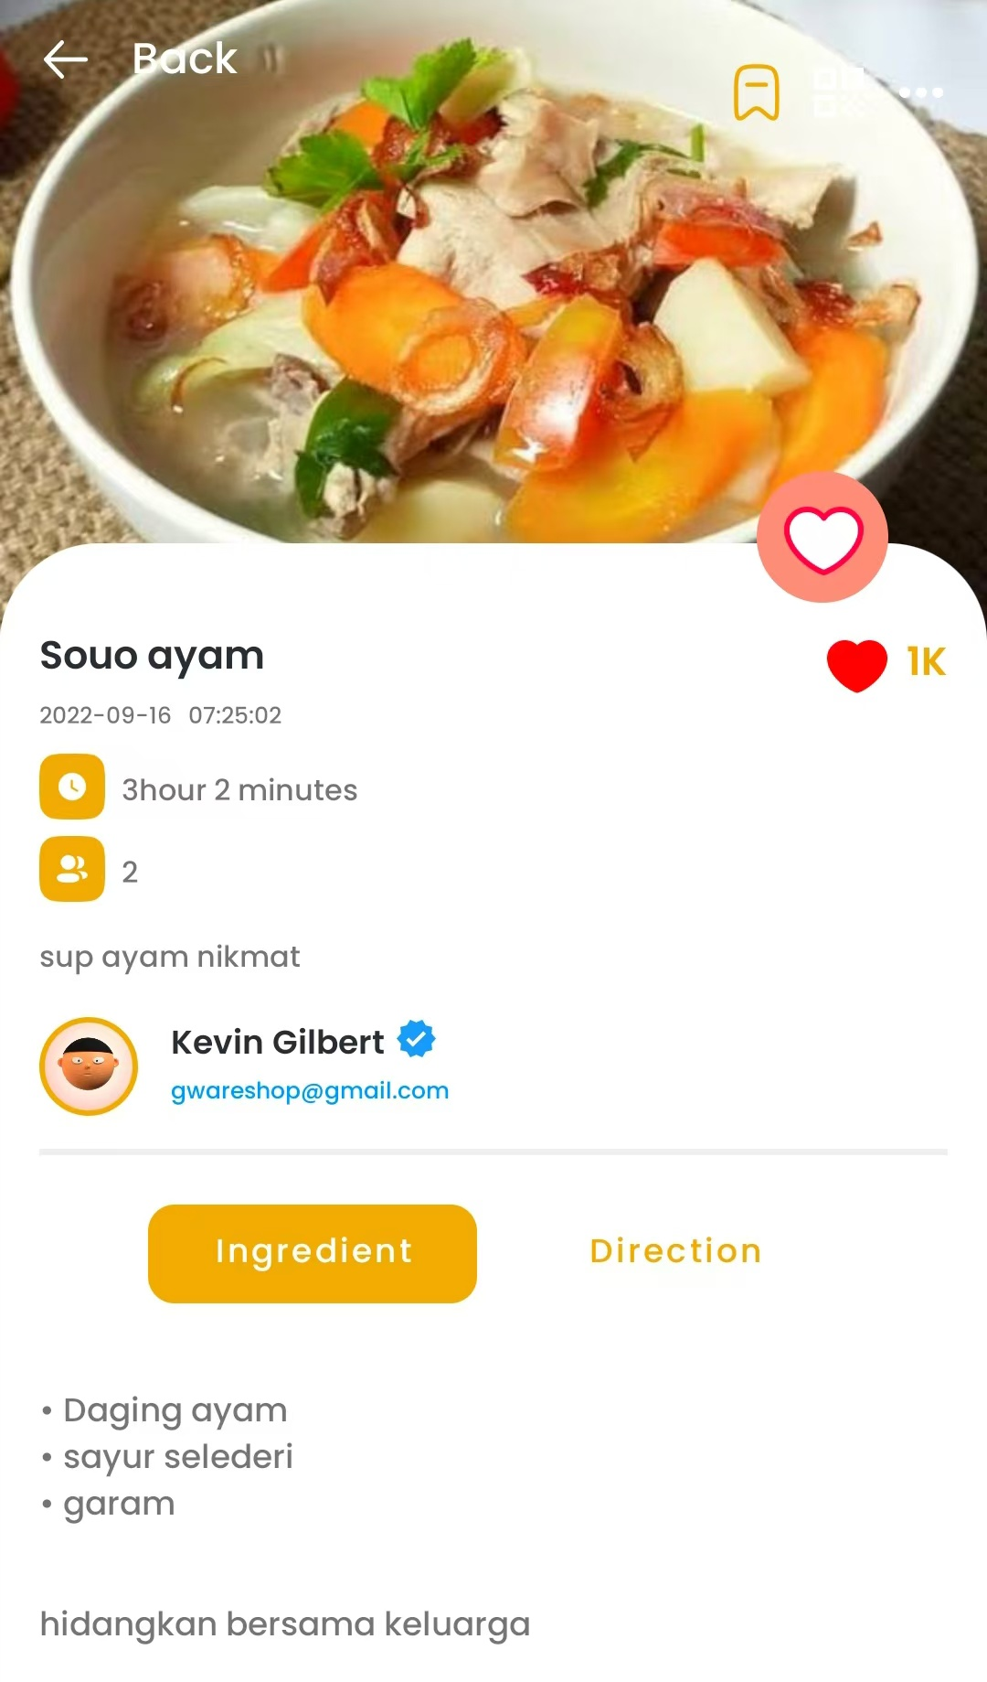
Function Achieved 1
1
Recipe Detail View Changed
Here is the original page of detail recipe, the ingredients are displayed in plain text in a text view
Not clear (especially for those who cannot cook based on experience)

Slide 6
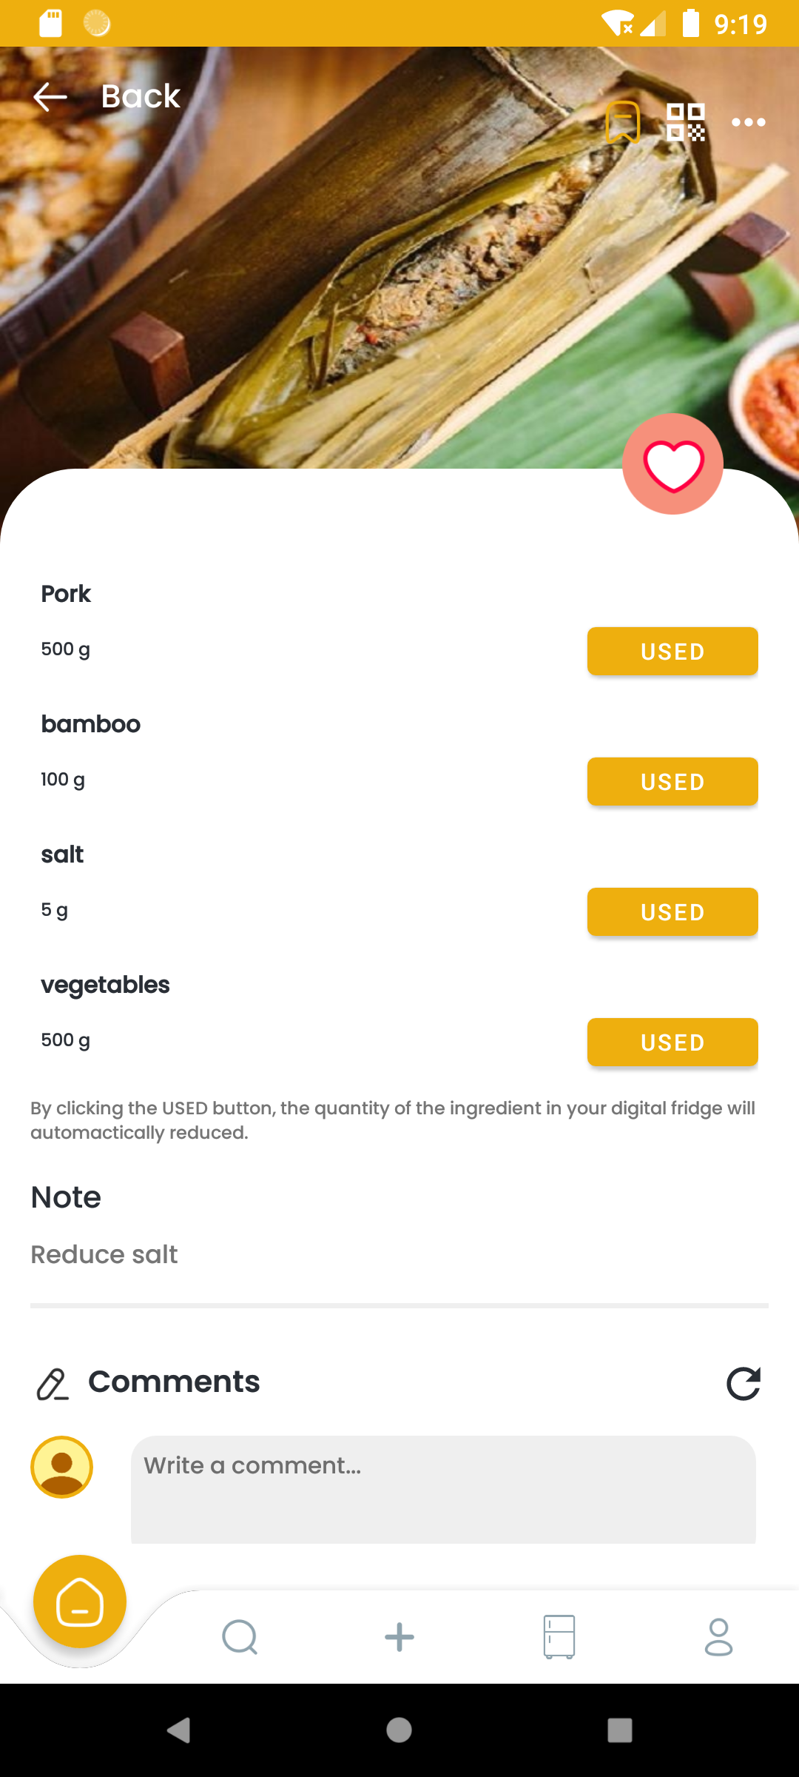
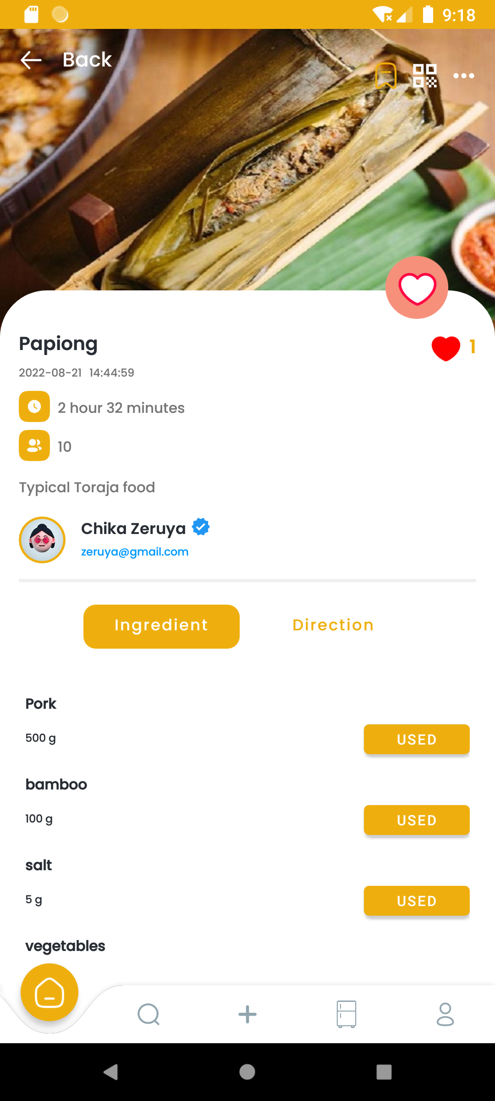

Function Achieved 1
1
Recipe Detail View Changed
Clearer: The ingredients are displayed in a recycler view, like a formatted list
Add a “USED “ button after each, after clicking, the quantity of that item in your digital fridge will decrease automatically.
After action, a toast will notify you what it done.

Slide 7
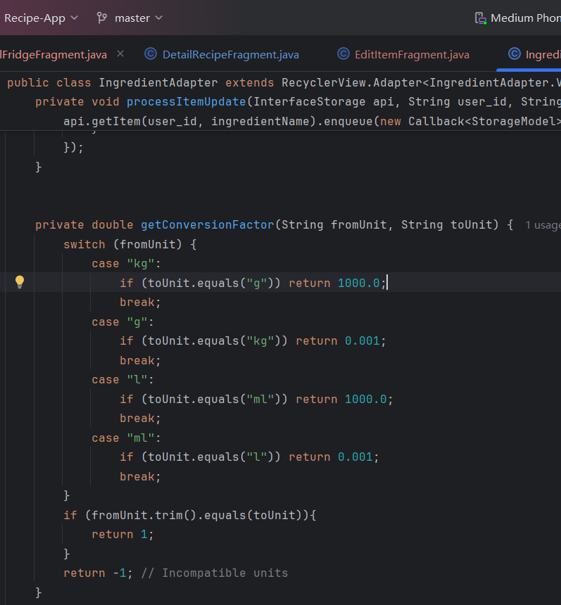
Code explanation
This method handles conversions between different units (like kg to g or l to ml) and returns the conversion factor. If units are incompatible, it returns -1.
This method is used to compute the quantity need to be updated

Slide 8
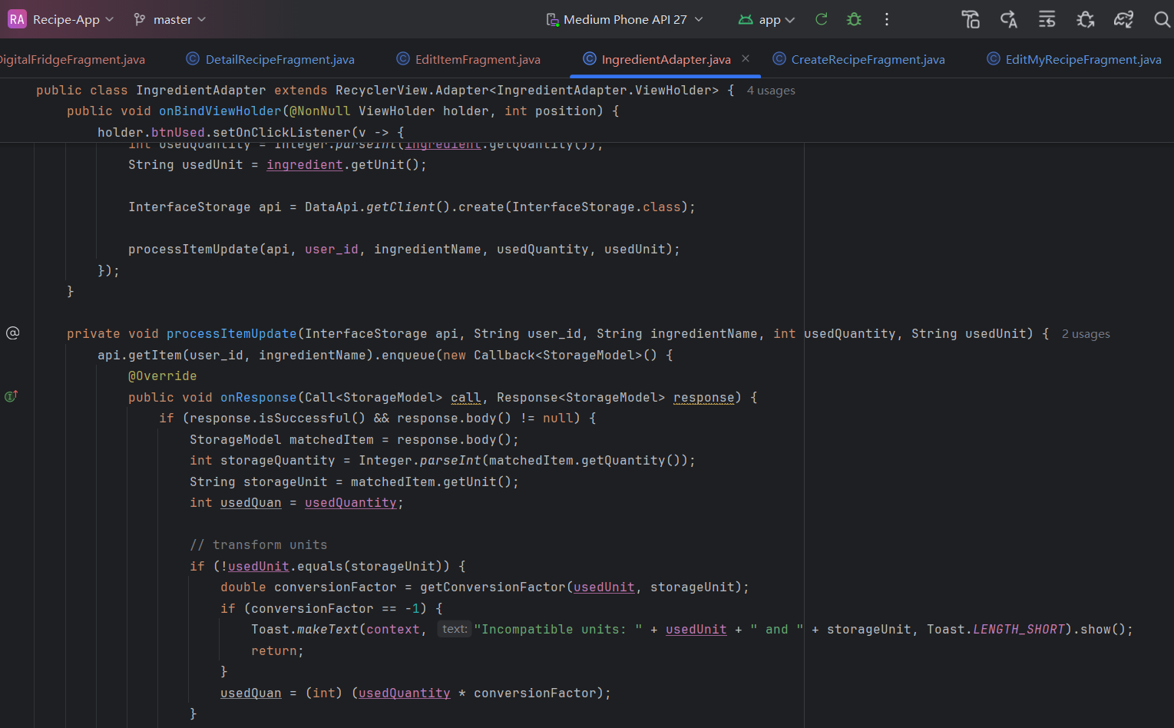
Code explanation
If the unit did not match at all, return an error message

Slide 9
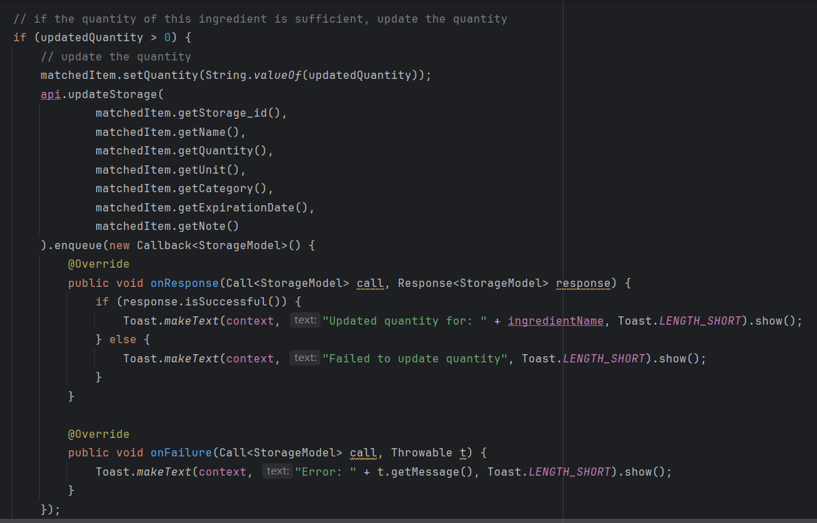
Code explanation
Based on the updated quantity calculated by subtracting the used quantity from the stored quantity:
If sufficient quantity remains, it updates the quantity using another API call (updateStorage).

Slide 10
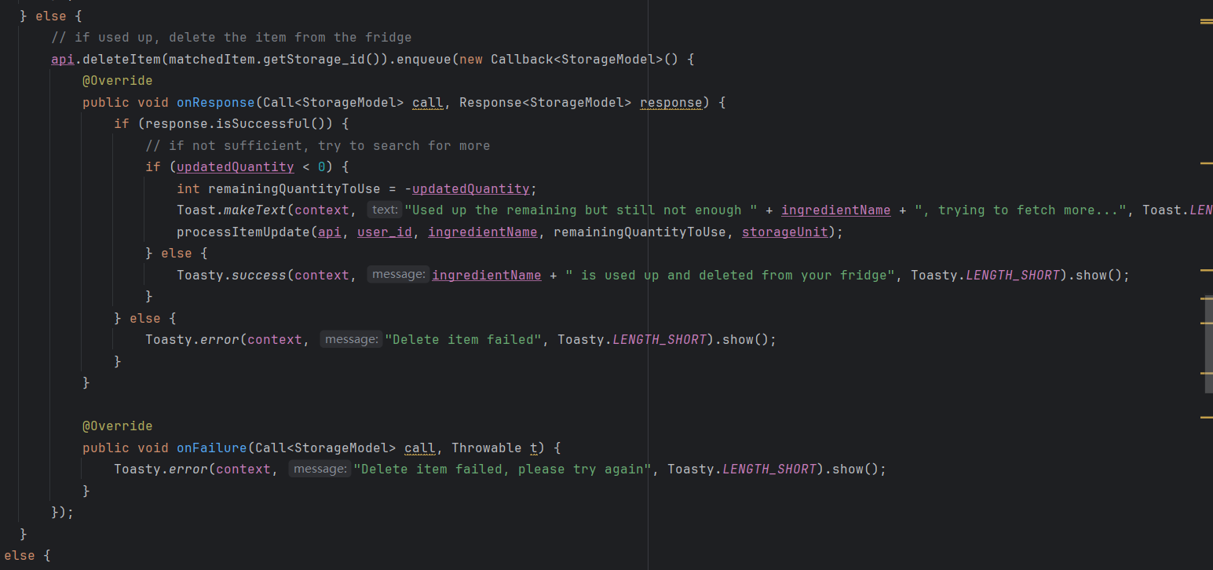
Code explanation
If completely used up, it deletes the ingredient from storage using the deleteItem method.
If there's still a need for more of the ingredient after using the available stock, it attempts to fetch more of that ingredient from storage.

Slide 11
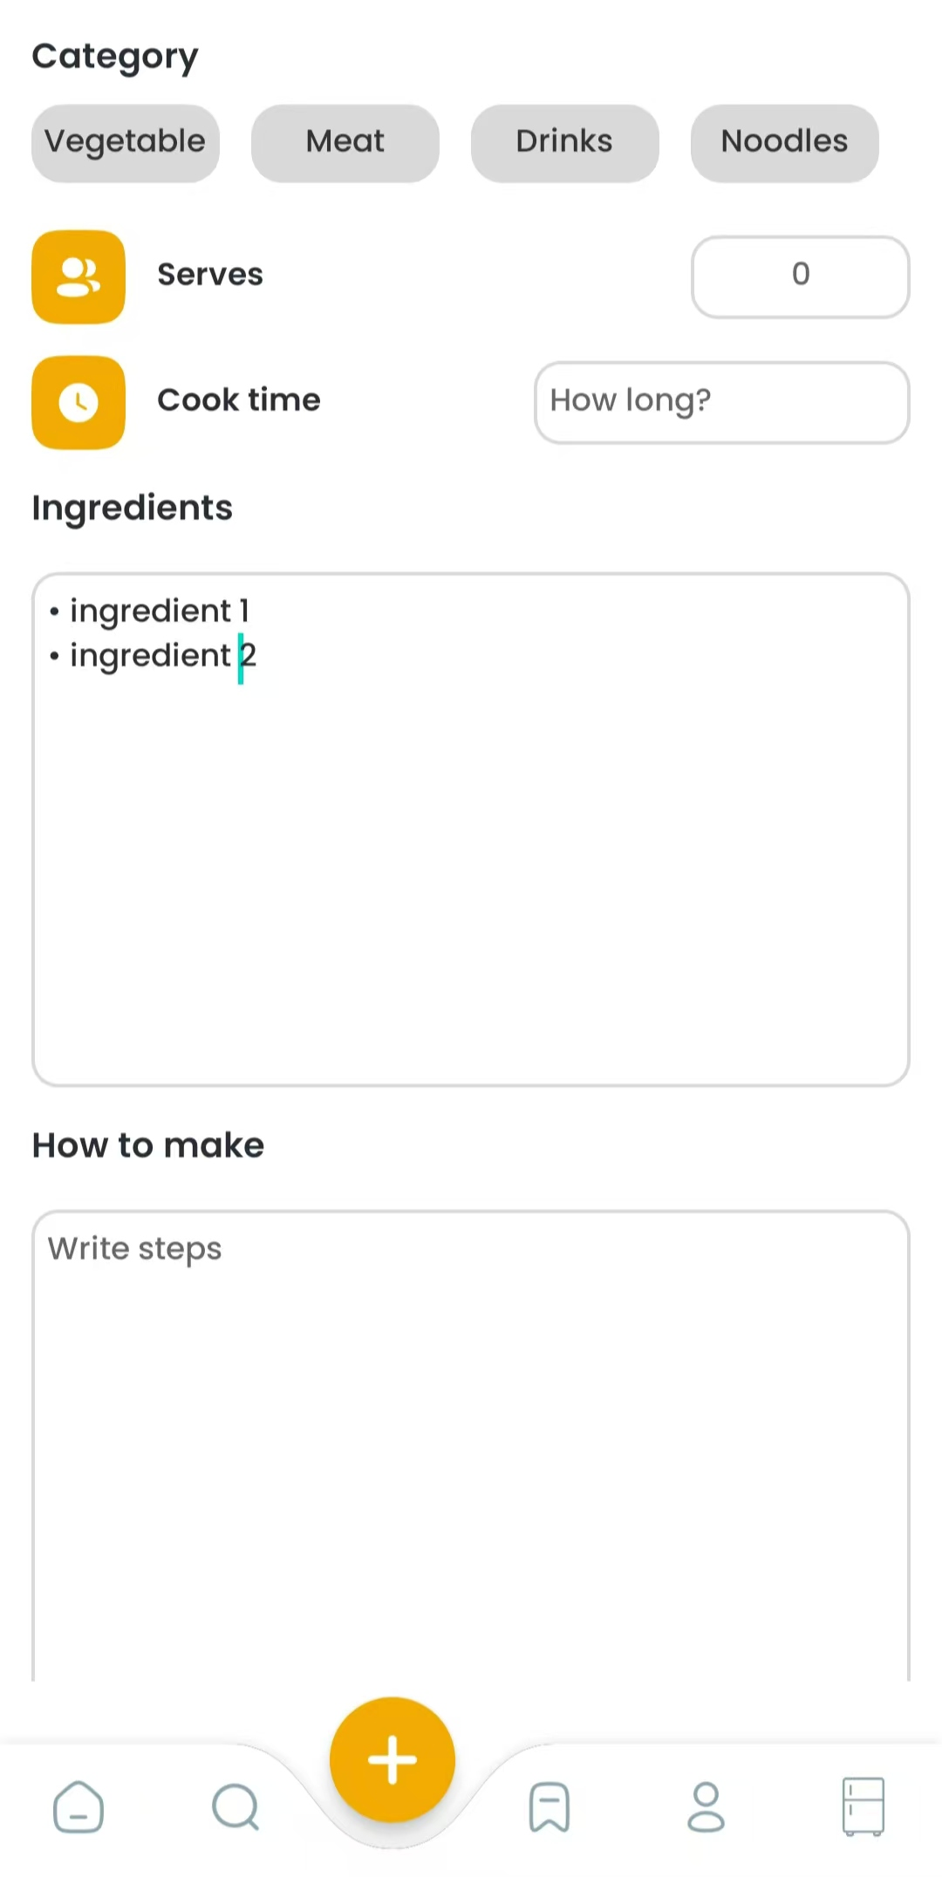
Function Achieved: 1
2
Create & Edit Recipe View Changed
Here is the original page of creating a recipe
Plain text, cannot ensure every handle to the econtext

Slide 12
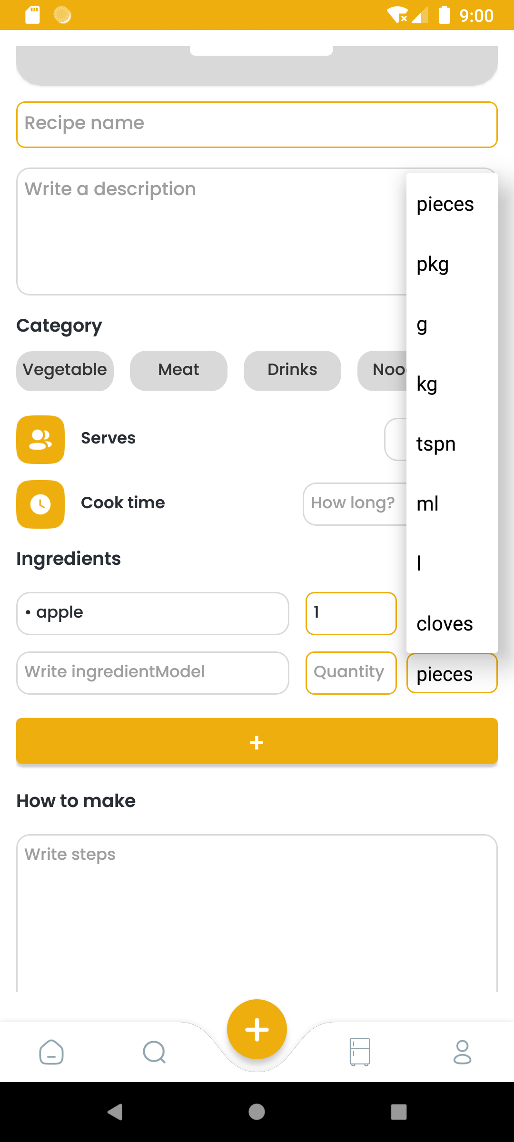
Function Achieved: 1
2
Create & Edit Recipe View Changed
Modified the create recipe page to require specific quantity and unit for each ingredient.
Users must select units from predefined options, ensuring compatibility with stored ingredient units.
Updated image selection and upload logic to fit in with the current system.

Slide 13
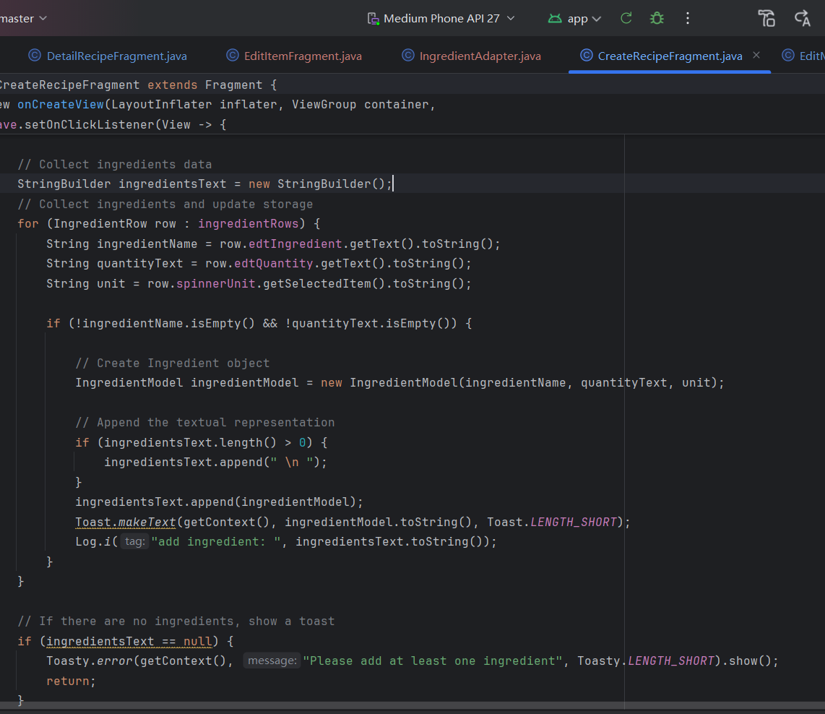
Code explanation
The input need to restructured and stored, so that the detail page can perform accordingly correct.

Slide 14
Function Achieved 2:
Add Category Tab Layout
A tab layout is placed under the search bar so users can view their items based on their category.

Slide 15
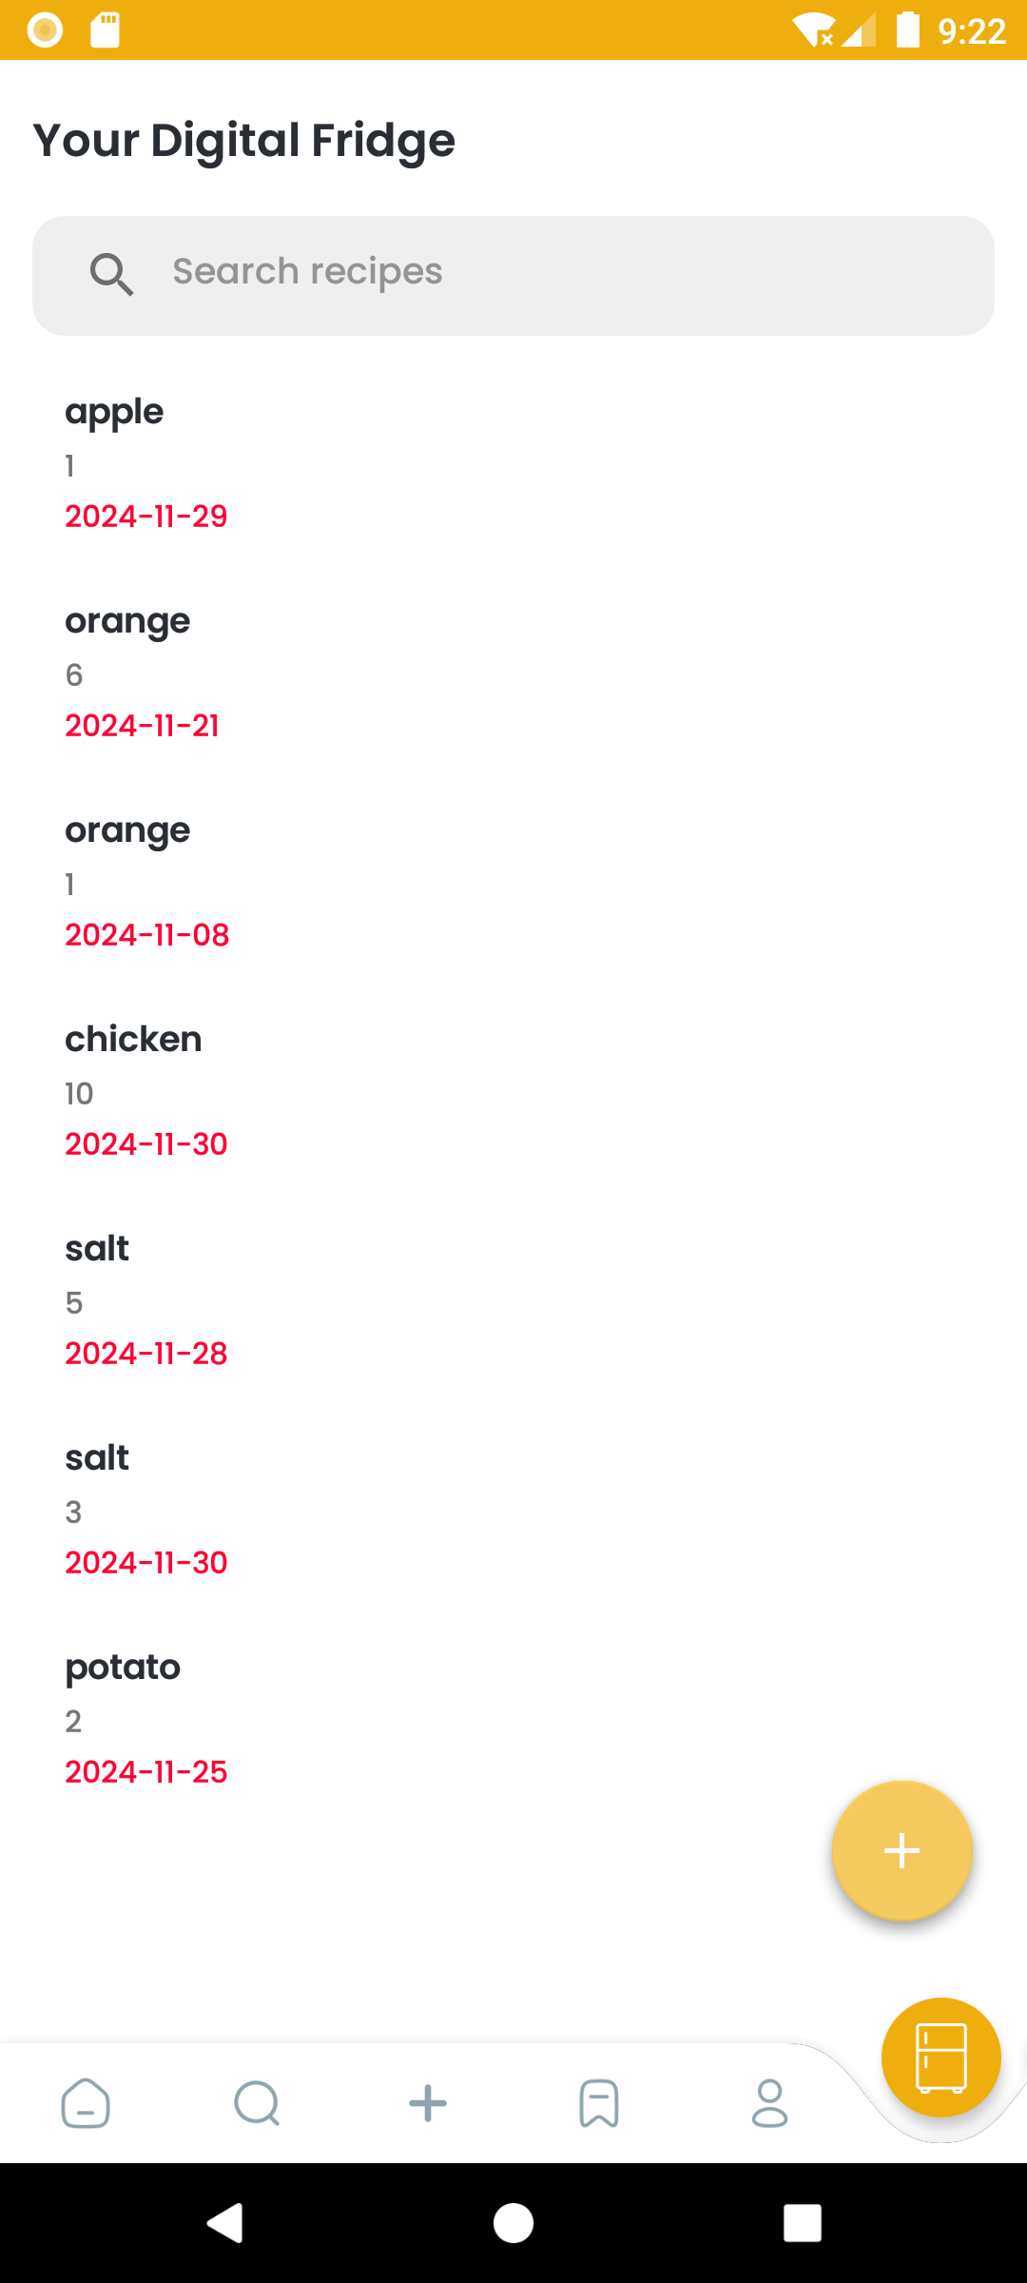
Function Achieved: 2
3
Storage Category Filter
This is the original page of the detail page, very basic.

Slide 16
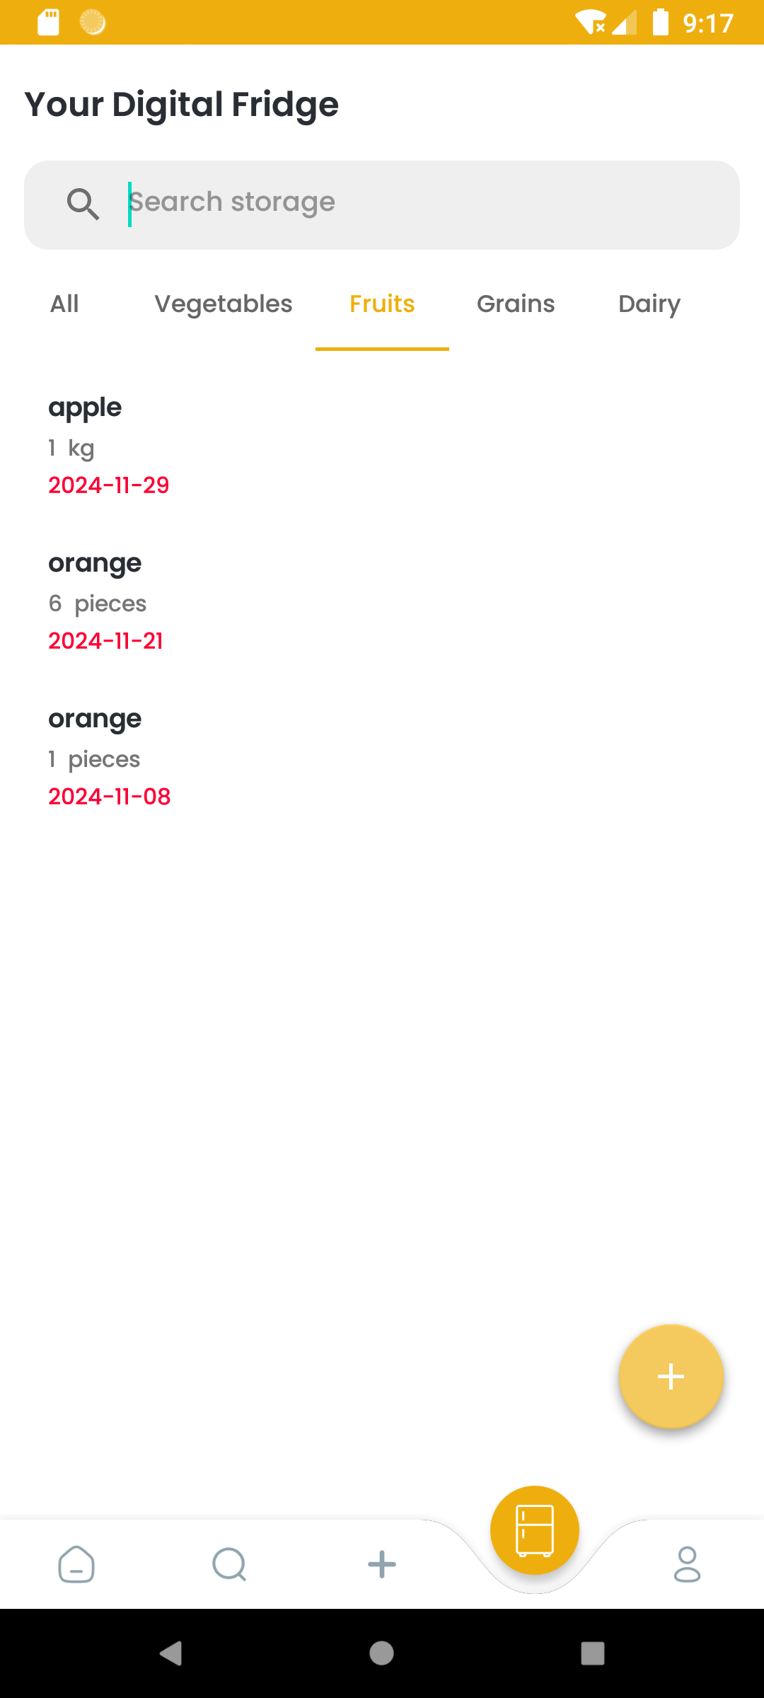
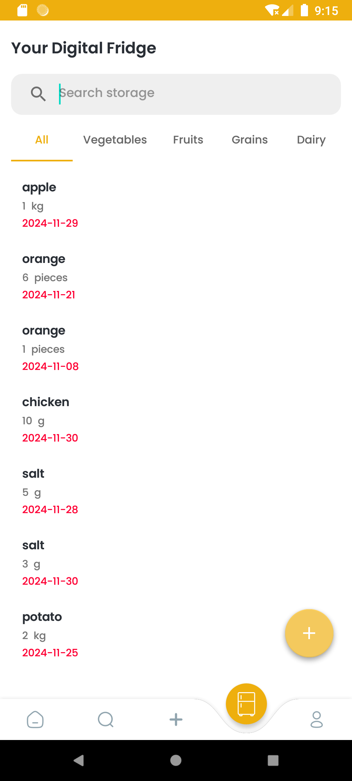
Function Achieved: 2
3
Storage Category Filter
Added category tabs in the Digital Fridge Display page, allowing users to filter and view ingredients by category easily.

Slide 17
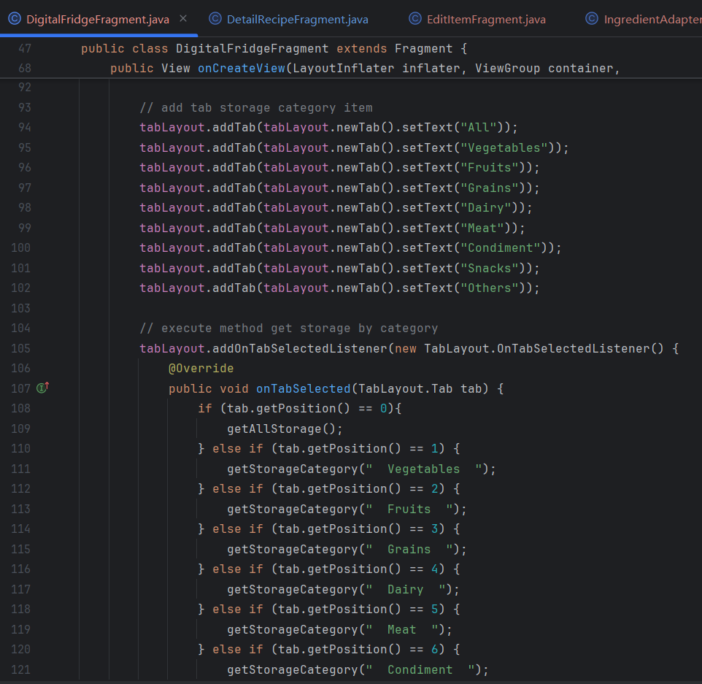
Code explanation
Add the category to the tab layout
When clicking different position, the “getStorageCategory()” method will be called with different parameters to search for those belong to a category

Slide 18


Function Achieved
4
UI Refinements
For example, the sizes and format of each page
The bottom bar to switch

Slide 19
Description of Finalized Features/ Improvement | Progress
Feature 2 (Newly added): Automatically decrease the quantity of an ingredient in the digital fridge when it is used in a recipe. Users can click the "USED" button to update quantities or delete items that are completely used. | Done.
Improvement 2: Enhanced Recipe Detail View: Replaced simple text views with a formatted recycler view for displaying ingredients, each with an "USED" button. Add functionality to handle unit conversions to prevent compatibility issues. Create and Edit Recipe Improvements: Modified the create recipe page to require specific quantity and unit for each ingredient. Users must select units from predefined options, ensuring compatibility with stored ingredient units. Updated image selection and upload logic to fit in with the current system. Storage Category Filter: Added category tabs in the Digital Fridge Display page, allowing users to filter and view ingredients by category easily. UI Refinements: Redesigned the bottom page-switching bar based on user preferences. Consistently adjusted parameters across pages for a uniform style and improved usability. | Done.

Slide 20
THANKS FOR WATCHING

